Slide 1
FINAL PROJECT TEMPLATE

Slide 2
THREAT SUMMARY
Summary of Situation: The attack has begun with a phishing attack sent by FIN4 that targeted an unaware employees who opened an attachment containing a malware that got executed by exploiting an unpatched windows vulnerability, which then it locked the system, preventing three hospitals from accessing their data demanding a payment in return.
Asset: Hospital A, Hospital B and Hospital C control systems used to monitor patient stats, doctors report and log analysis tool.
Impact: The entire CIA triad.
Threat Actor: FIN4 group and employees who launch the malicious attachment.
Threat Actor Motivation: It targets individuals that have inside information about stocks. In short, the threat actor has a financial motivation.
Common Threat Actor Techniques: -
Command and scripting interpreter.
Email collection.
Input capture, keylogging and GIU input capture.
Phishing: sending malicious email using spearphishing.
Proxy: Multi-hop Proxy.
Valid accounts.

Slide 3
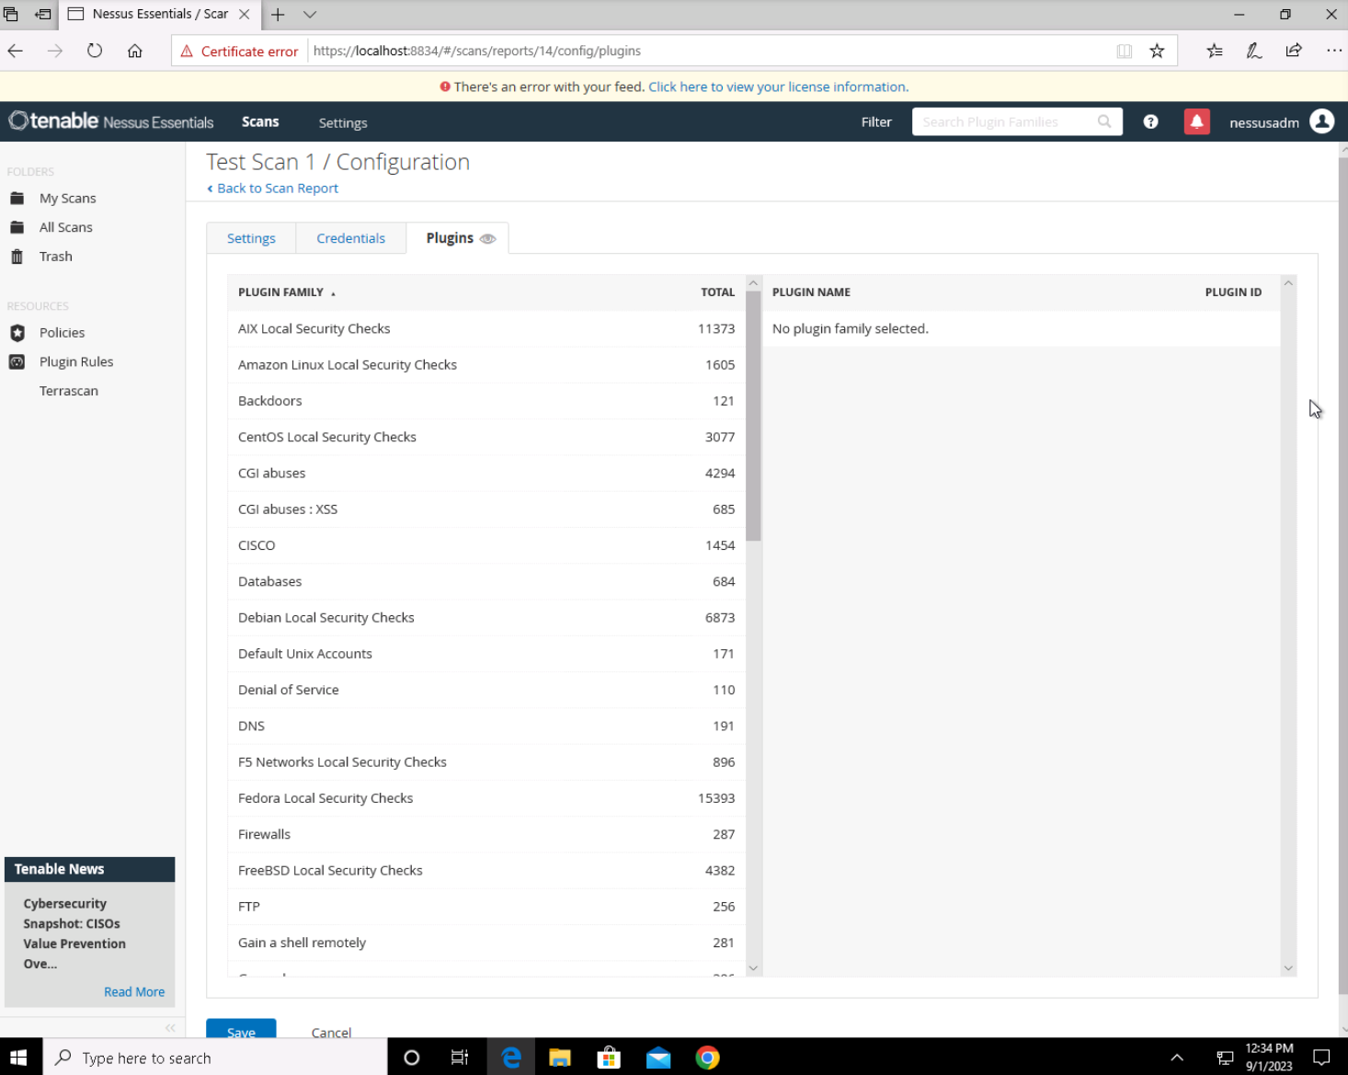
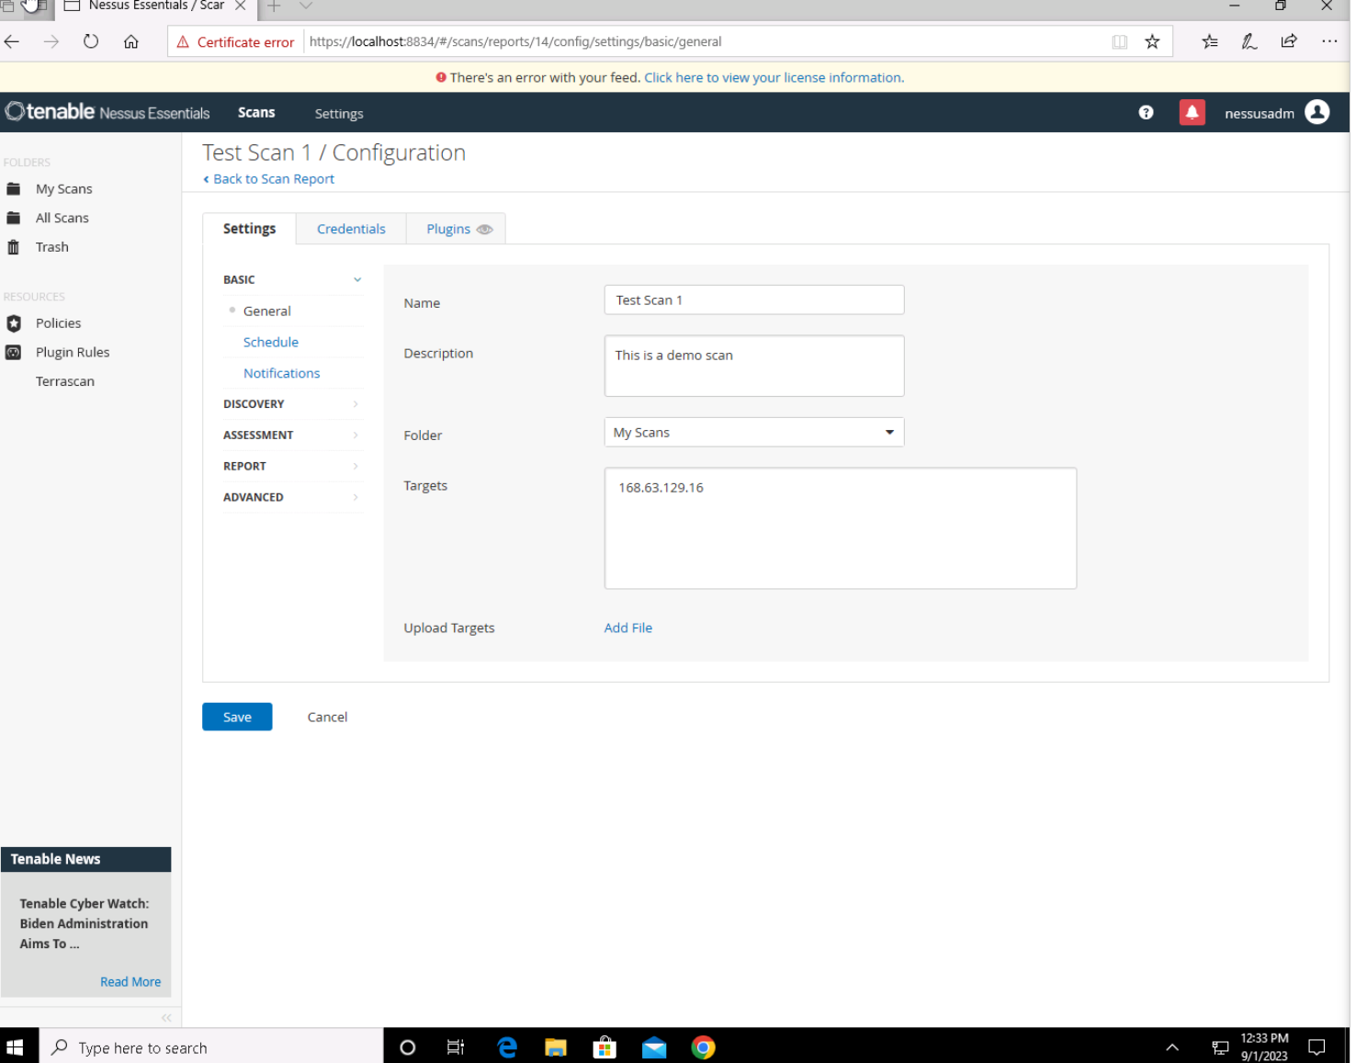
VULNERABILITY SCANNING TARGETS
Summary of scan targets:
Number of devices scanned: One device
Device type: Windows system CLM.
Primary purpose of device: Used to log data from multiple resources and backup.
(insert 2 screenshots from scan configuration window – one of the settings tab and one of the plugins tab)

Slide 4
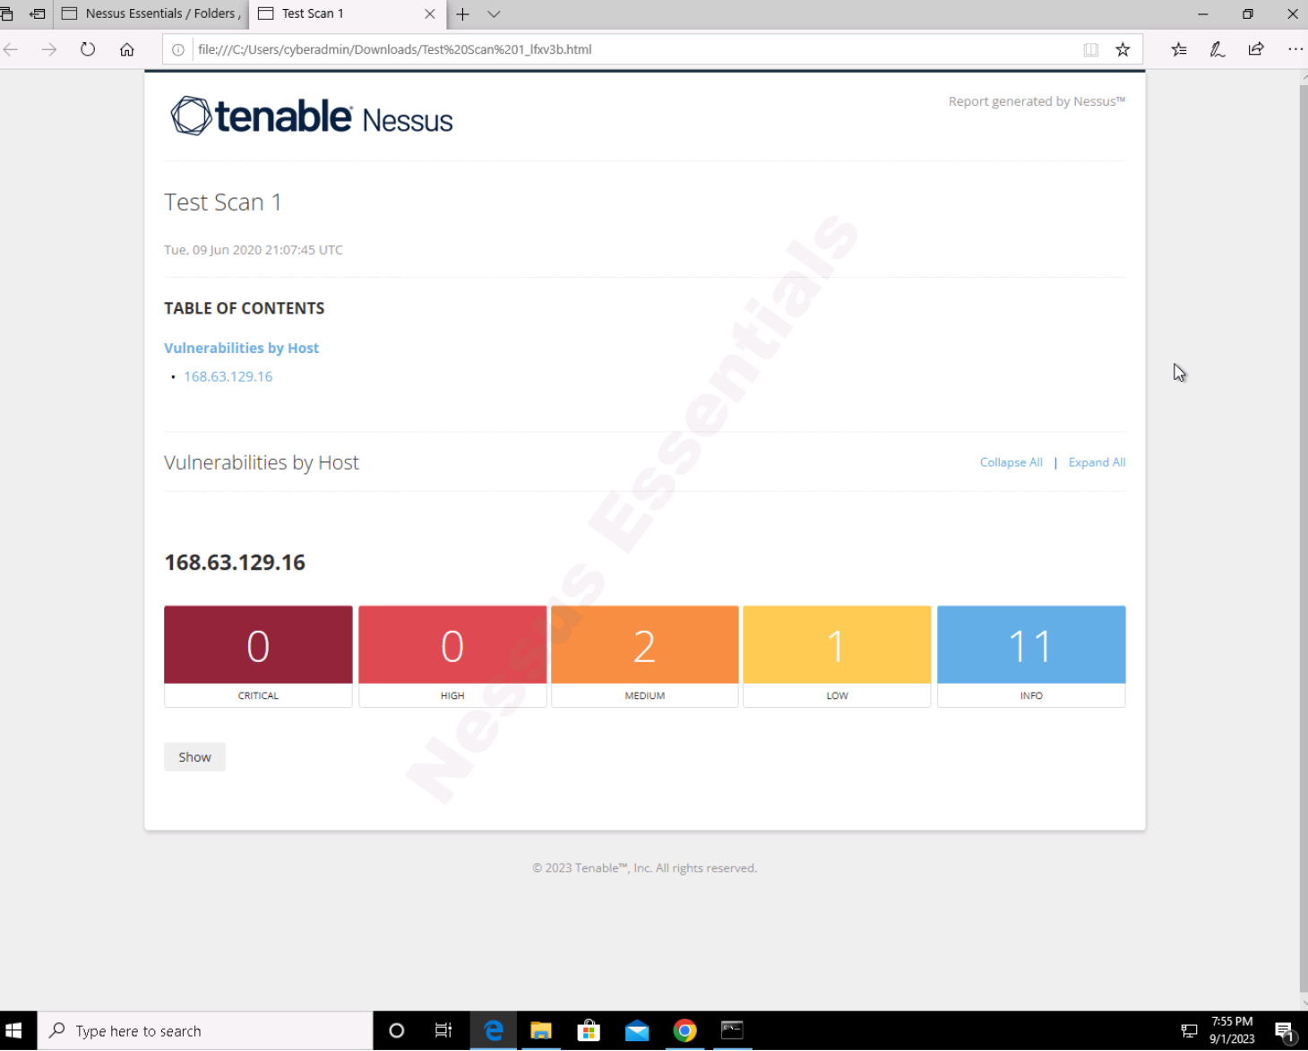
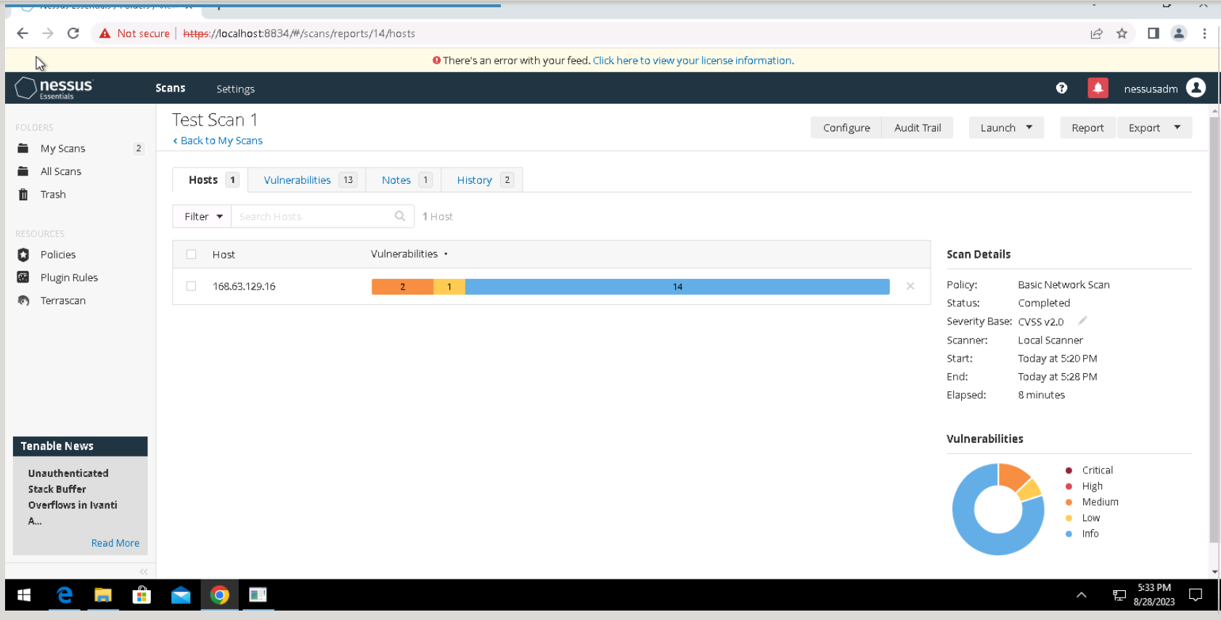
VULNERABILITY SCAN RESULTS
Summary of findings:
Total number of actionable findings: 3
Critical:
High:
Medium: 2
Low: 1

Slide 5
REMEDIATION RECOMMENDATION
Fix within 7 days
Finding | Severity Rating | Recommended Fix
CVE-1999-0024 | Medium | Restrict recursive queries to the hosts.
CVE-2006-0987 | Medium | Restrict access to the DNS server from public network or configure it to reject such queries.
Fix within 30 days
Finding | Severity Rating | Recommended Fix
DHCP Server Detection | Low | Apply filtering to keep this information off the network and remove any options that are not in use.
Fix within 60 days
Finding | Severity Rating | Recommended Fix

Slide 6
PASSWORD PENETRATION TEST OUTCOME
Methodology: I downloaded a common password file then I wrote the below command for hashcat : -
$hashcat.exe –m 0 –a 0 –D 1,2 hashes.txt best110.txt --show
-m 0 : for hash mode.
-a 0 : attack mode.
-D 1,2 : to enable GPUs and CPUs.
-O : to increase the password-cracking speed.
--show : runtime details.
Number of passwords tested: 41
Number of passwords cracked: 38
Evidence of weak passwords: (Next Slide)
Recommended steps to improve passwords security: -
The following steps should be Implemented to improve passwords security: -
Use a mix of letters, numbers and special characters.
Use a unique password for different accounts.
Passwords should get changed frequently
Passwords should have more than 12 characters.

Slide 7
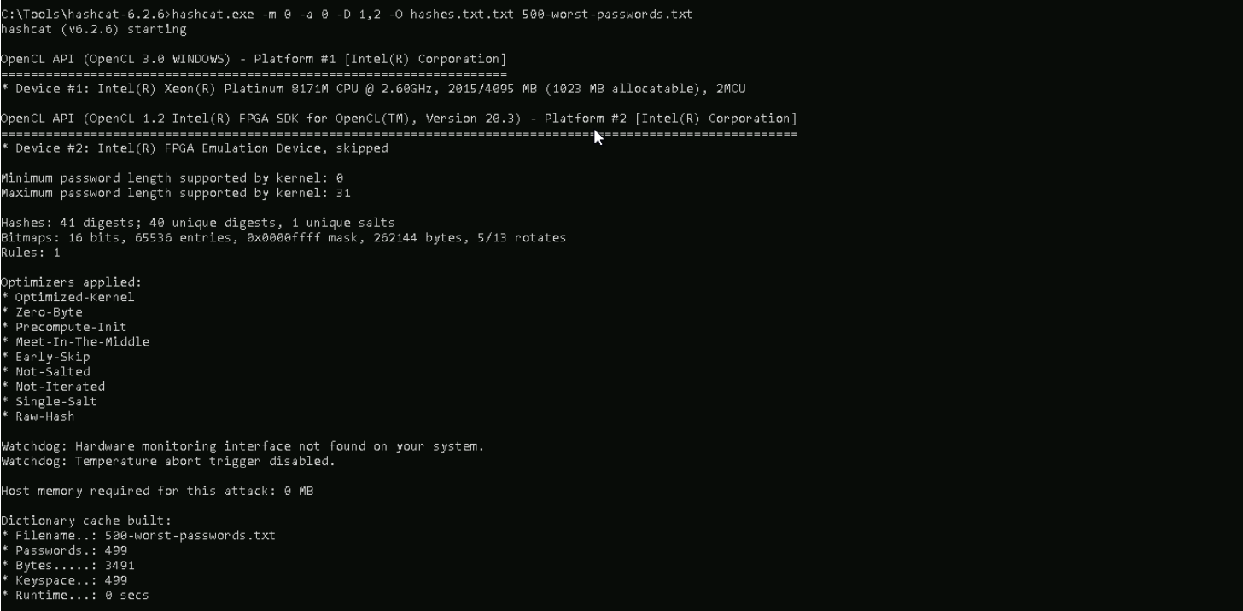
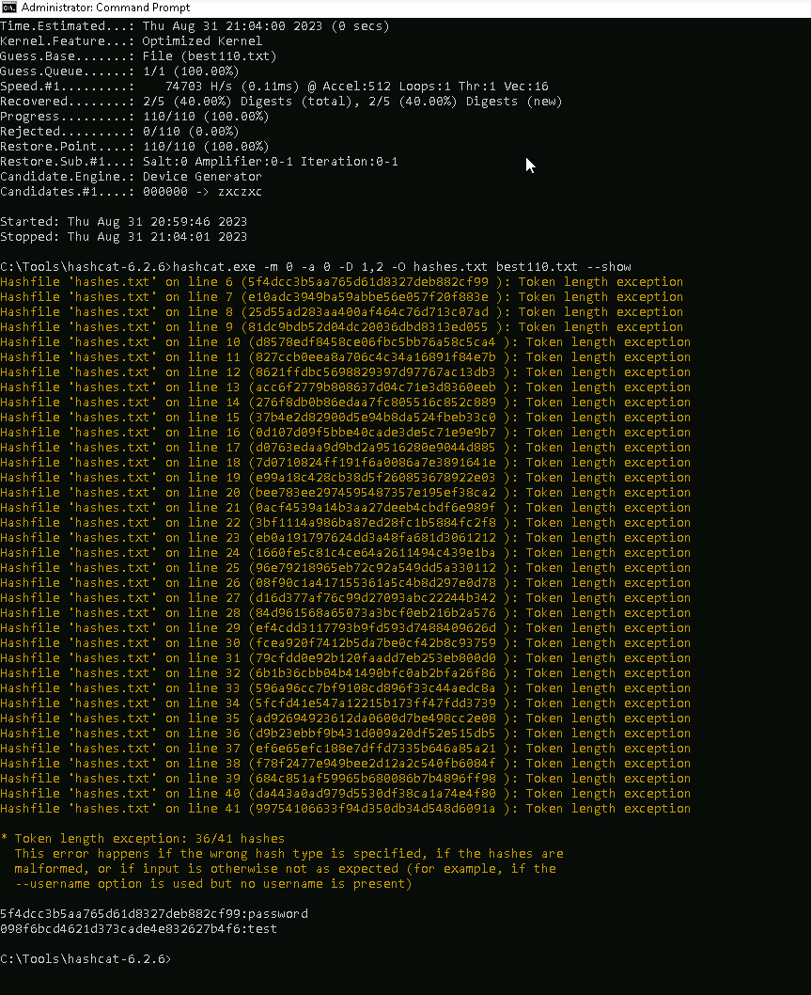
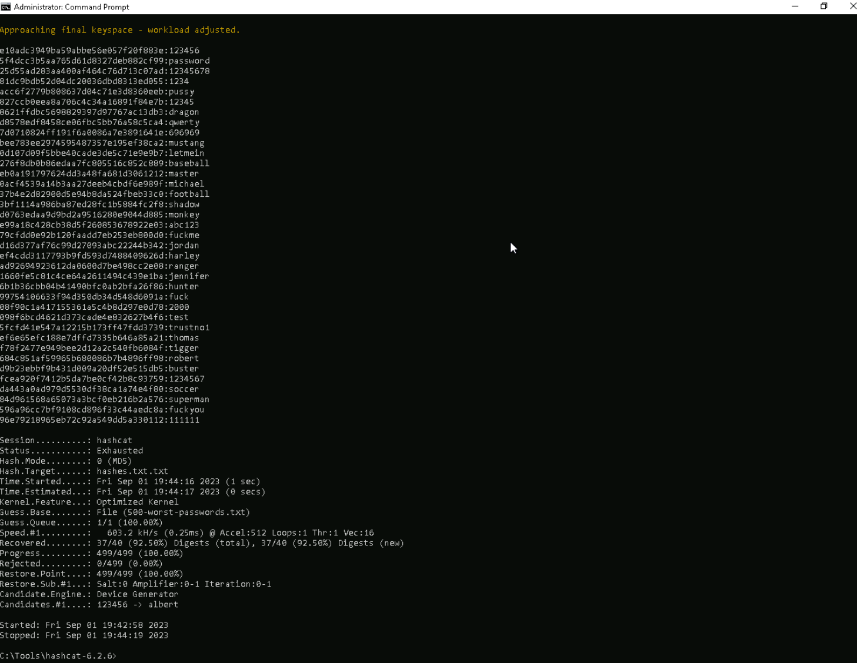

Slide 8
INCIDENT RESPONSE PRELIMINARY ASSESSMENT
Summarize ongoing incident:
The attackers are exploiting an unpatched Windows vulnerability to execute the attack along with exploiting weak passwords the employee are using to attack CLM of the hospitals for financial motivation.
Document actions or notes from the following steps of the initial incident response checklist
Step 1: Doctors, nurses, and administrative staff reported the ransomware because they could not access their data anymore.
Step 2:
A) Indicator of compromise is the ransomware attacks.
B) An encryption of important data that belongs to patients, employees and stakeholders along with financial loss.
C) System: CYBER-ND03-W10 - Operating System: Windows 10 Pro - IP address: 168.63.129.16.
Step 3:
A) Incident is confirmed
B) Incident still in progress
C) It needs an urgent response since it’s attacking the whole CIA triad and the reputation of the hospital.
D) The response will alert the attacker since they might installed a backdoor to the machine.
E) Malware.
Step 4: Any individual that are associated with the attack are on a high risk.
Step 6: Category three - A threat to computer systems data ticket should be opened because the threat actor has installed the malware by exploiting an unpatched Windows vulnerability.

Slide 9
INCIDENT RESPONSE RECOMMENDED ACTION
Summarize recommendation to contain, eradicate, and recover:
An appropriate incident response procedure should be followed and documented.
An infected machine should be isolated to get scanned to identify the malware.
The infected machine should be restored to a clean backup to ensure that the malware is completely removed.
Documented actions and notes from the IR checklist
Step 7: Malware response procedure.
Step 8: Every logs that was associated with the employee who opened the email should get documented for investigations.
Step 9: B, C, D and E.
Step 12: A, D and E.

